Slide 1
State vs Trait
Constructs

Slide 2
Project question 4
Does your test measure a state or a trait?

Slide 3
Criterion vs Norm referenced
Criterion reference = compares to established standard, well defined objectives
Norm referenced = compares each score to other scores, relative

Slide 4
Norms
Types of norms?????

Slide 5
Project question 5
What sort of norms would be appropriate to collect to standardize your measure?
Why did you select those norms?

Slide 6
Sampling
Random
Stratified
Purposive
Incidental/convenience

Slide 7
Correlations
NOT causal
relationship between variables
predictive

Slide 8
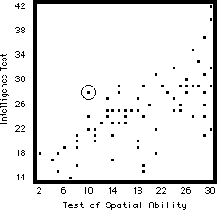
Scatterplot

Slide 9
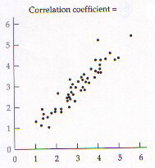
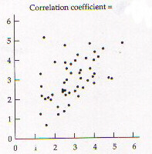
Positive Correlation

Slide 10
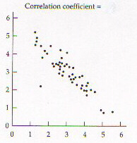
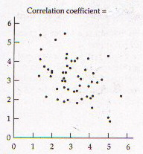
Negative Correlation

Slide 11
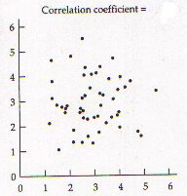
No correlation

Slide 12
Correlation values
-1 to +1
.56, -.45, -.09, .89, -.93

Slide 14
Appropriate Correlations
1 - data must be linear not curvilinear (determine by scatterplot)

Slide 15
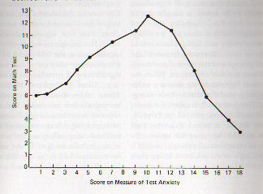
Curvilinear

Slide 16
Appropriate Correlation to use
1 – linear data
2 - type of scale
interval (or ratio) = Pearson r
ordinal = Spearman rho
3 - number of subjects
more than 30 = Pearson
fewer than 30 = Spearman

Slide 17
Decision Tree
Linear
No = no corr yes = corr
Scale
ordinal = rho interval = r
number
< 30 = rho > 30 = r

Slide 18
Project question #6
Which correlation formula would you use when correlating the scores from your measure with another variable?
Why would you use that formula?

Slide 19
Multiple correlations
Correlations between more than one variable done at the same time.

Slide 20
Multiple regression
Relationship between more variables
Uses specific predictor and criterion variables
Looks at relationships between predictors
Can factor out partial relationships

Slide 21
Multiple regression - example
Grad school grade performance = criterion (or outcome)
Predictor variables
= undergrad GPA
= GRE scores
= Quality of statement of purpose

Slide 22
Multiple regression data
Predictor Beta (=r) significance (p)
GPA .80 .01
GRE .55 .05
statement .20 .20

Slide 23
Multiple regression – example 2
Predictor variables = Metacognition, Locus of Control, Learning Style
Criterion variable = academic performance (grade)

Slide 24
Multiple regression data
Predictor Beta (=r) significance (p)
Meta. .75 .01
LofC .65 .05
L.S. .32 .15

