Slide 1
Intelligence
What is “intelligence”?
Why/how do we measure it?
What do we do with the scores?
Link to Human Intelligence Map

Slide 2
Major Issues
Theoretical vs. Psychometric base
One, two, or many factors
Nature vs. nurture
Individual or group administration
Verbal or non-verbal
Culture bias? Free? Fair?

Slide 3
Historical Perspective

Slide 4
1869 - Sir Francis Galton
“father of intelligence testing”
Hereditary Genius (eugenics)
sensory apparatus

Slide 5
1905 - Alfred Binet & Theodore Simon
Original test -
classification of mentally retarded
ability for sound judgements
age related tasks
1916 - Terman - US revision = Stanford/Binet

Slide 6
1927 - Spearman
Two-factor theory
g = general intellectual factor
s = specific factor
(e = measurement error)

Slide 7
1935 - Thurstone
Primary Mental Abilities (PMA)
7 Group factors
verbal comprehension
word fluency
number
space
associative memory
perceptual speed
reasoning

Slide 8
1939 - David Wechsler
adult intelligence (first, children later)
act purposefully
think rationally
deal effectively with environment
verbal and performance abilities
(also full scale)

Slide 9
1959 - Guilford
Three faces of intelligence
5 Operations - what a person does
5 Content - material it is done on
6 Products - form in which information is stored
(apply operation to content = product)
150 possible combinations

Slide 10
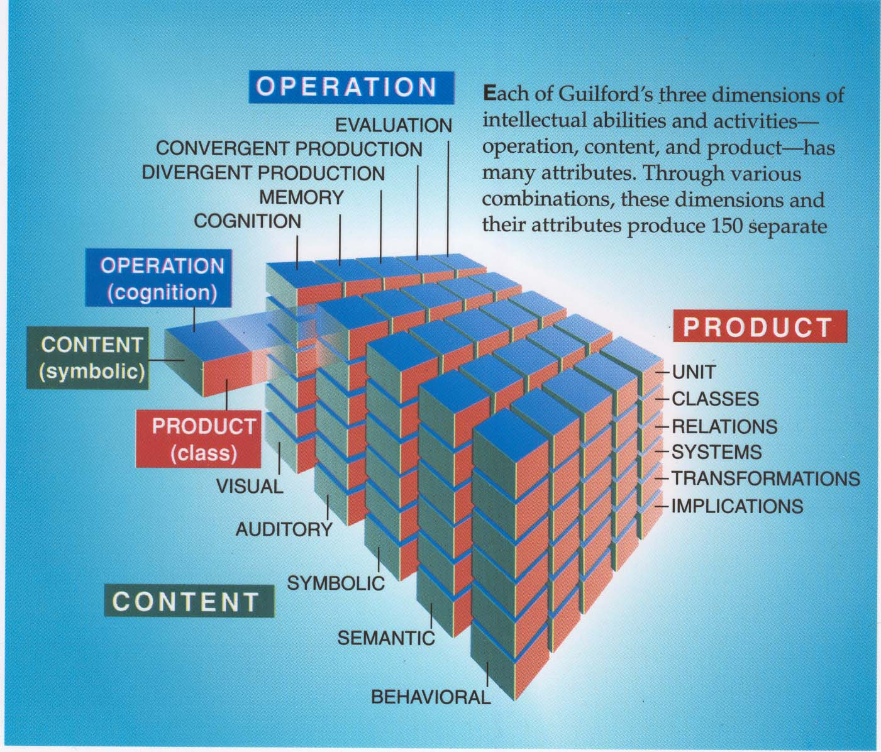
Guilford’s Model

Slide 11
1963 - Cattell
crystallized abilities = acquired knowledge and facts (declarative)
fluid abilities = reasoning (procedural)

Slide 12
1975 - Gardner
Multiple Intelligences
logical-mathematical
linguistic
spatial
musical
bodily-kinesthetic
interpersonal
intrapersonal
(naturalist, spiritual, existential)

Slide 13
1980 - Sternberg
“successful intelligence = the ability to adapt to, shape, and select environments to accomplish one’s goals and those of one’s society and culture” (1999)
Triarchic theory
metacomponents (metacognition)
performance components (procedural)
knowledge acquisition components
(declarative)

Slide 14
1960 - 90 Information Processing Approach
Aleksandr Luria
How information is processed, not What is processed
Parallel (simultaneous)
Serial (successive, sequential)

Slide 15
Information processing measures
Kaufman - (K-ABC)
Das and Naglieri = CAS (Cognitive Assessment System)
PASS – system
P = planning
A = attention
S = Simultaneous
S = Successive

