Slide 1
Non - Traditional Intelligence tests

Slide 2
Group Administered Tests
Army Alpha – 1917 - verbal
Army Beta – 1917 - nonverbal
Army test image

Slide 3
Non Verbal Tests of Intelligence

Slide 4
Comprehensive Test of Nonverbal Intelligence (CTONI-2)
“elimination of cultural, gender and linguistic bias”
Used with individuals with difficulty in language or fine motor skills
Ages 6 through 90 years
2009
Untimed (approximately 1 hour)
Cost = $426

Slide 5
Scores available:
Analogical reasoning
Categorical classification
Sequential reasoning
BASED ON:
-- Pictorial objects
-- Geometric designs
Reliability on all at least .80

Slide 6
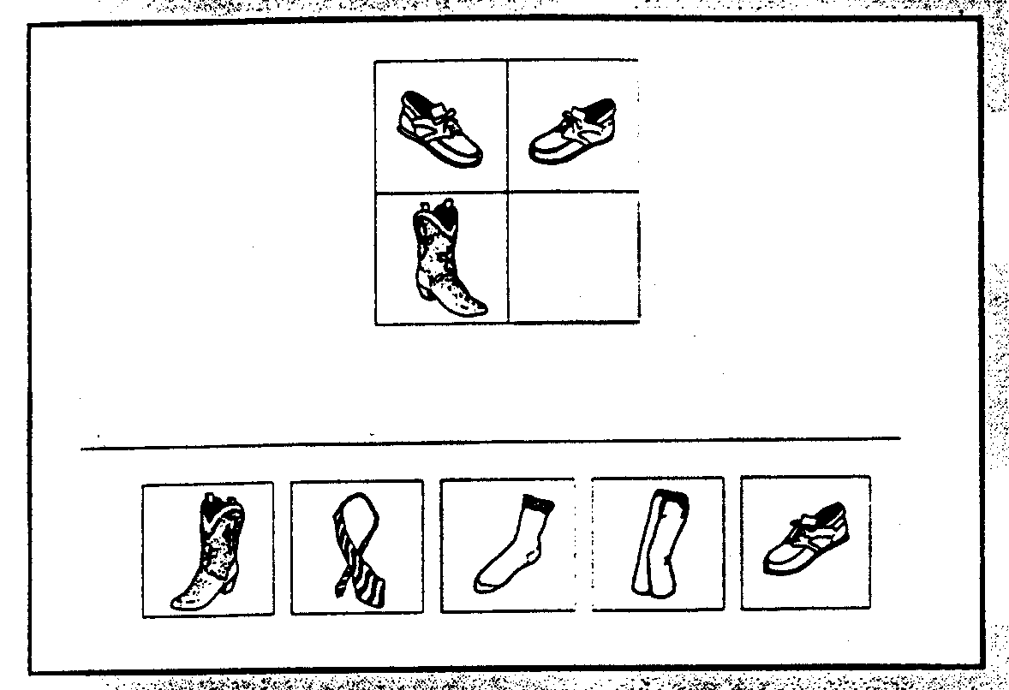
Analogical Reasoning - pictorial

Slide 7
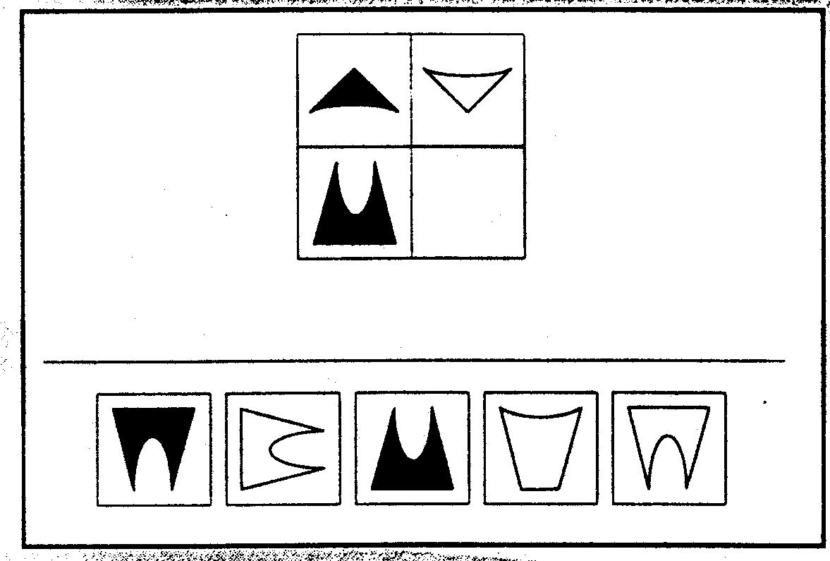
Analogical Reasoning - geometric

Slide 8
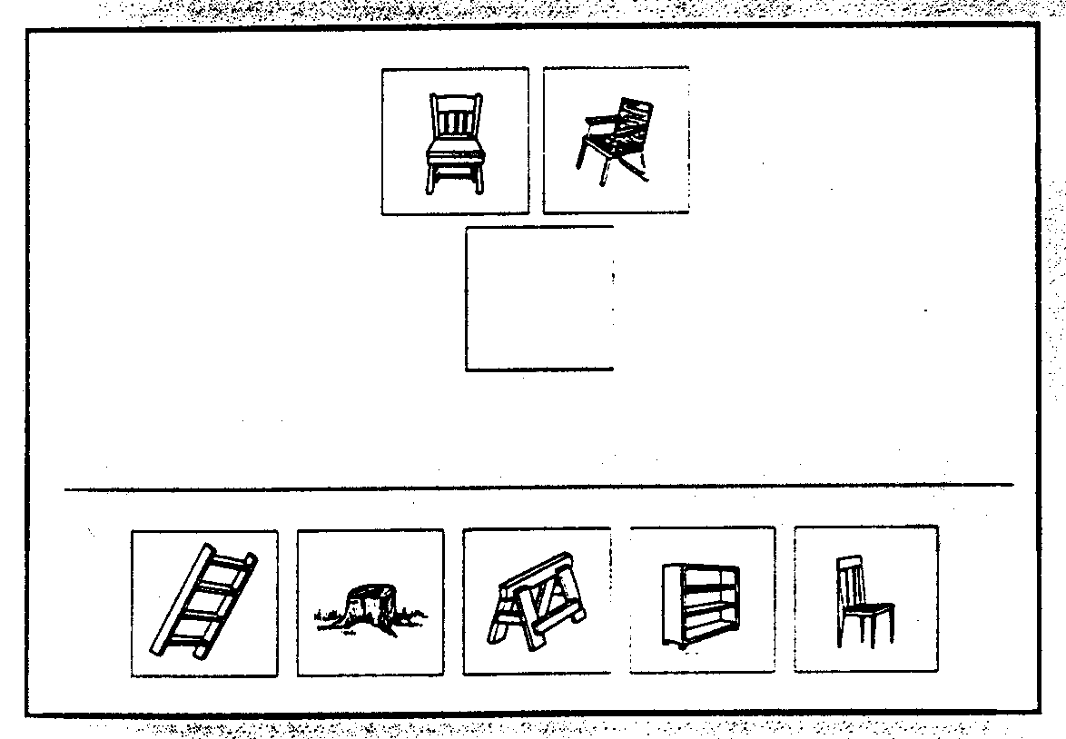
Categorical classification - pictorial

Slide 9
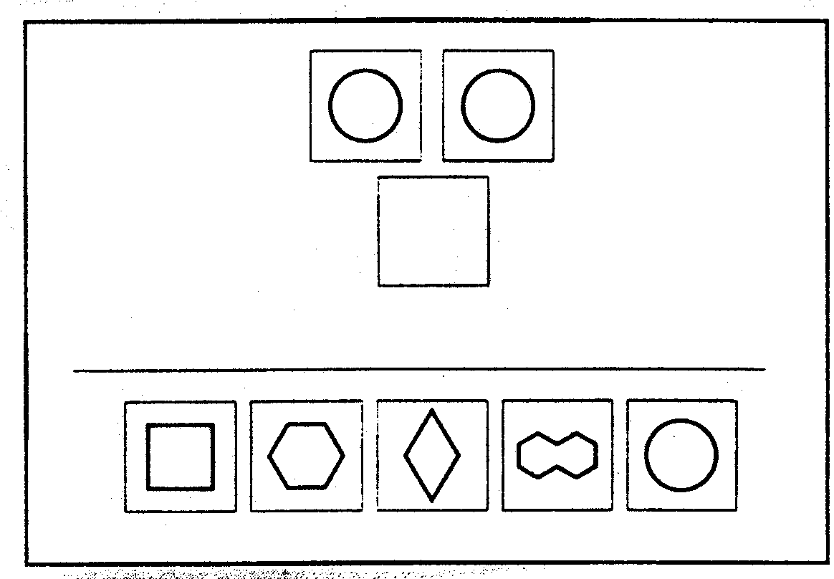
Categorical classification - geometric

Slide 10
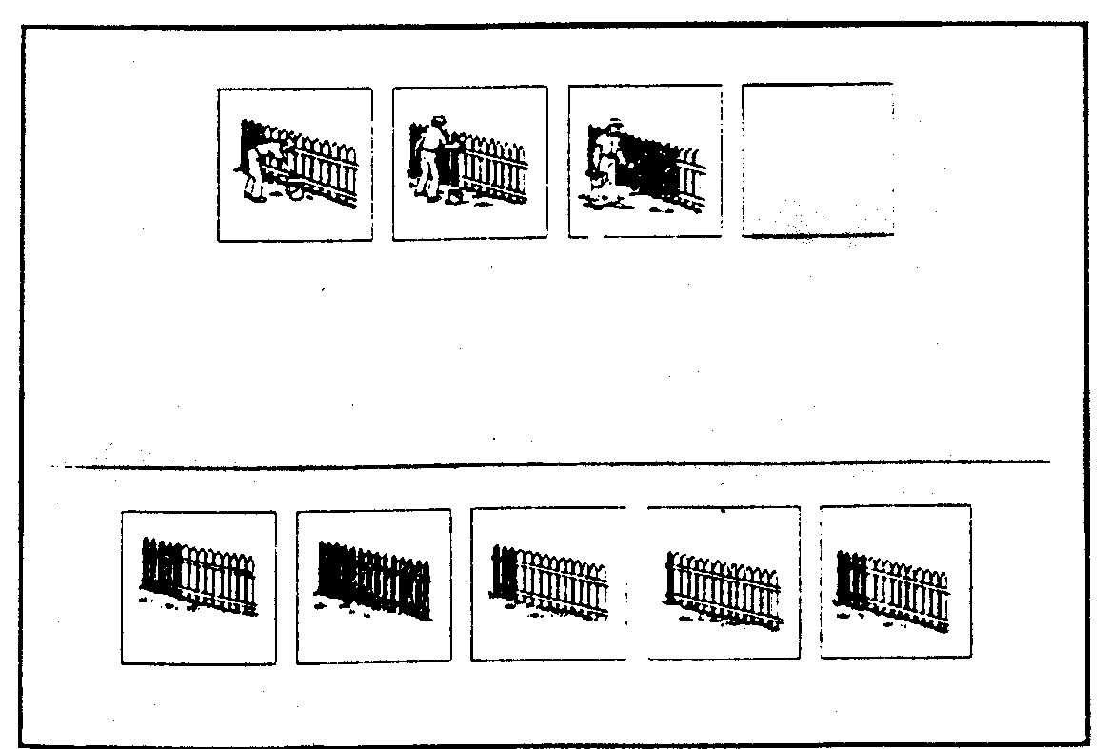
Sequential reasoning - pictorial

Slide 11
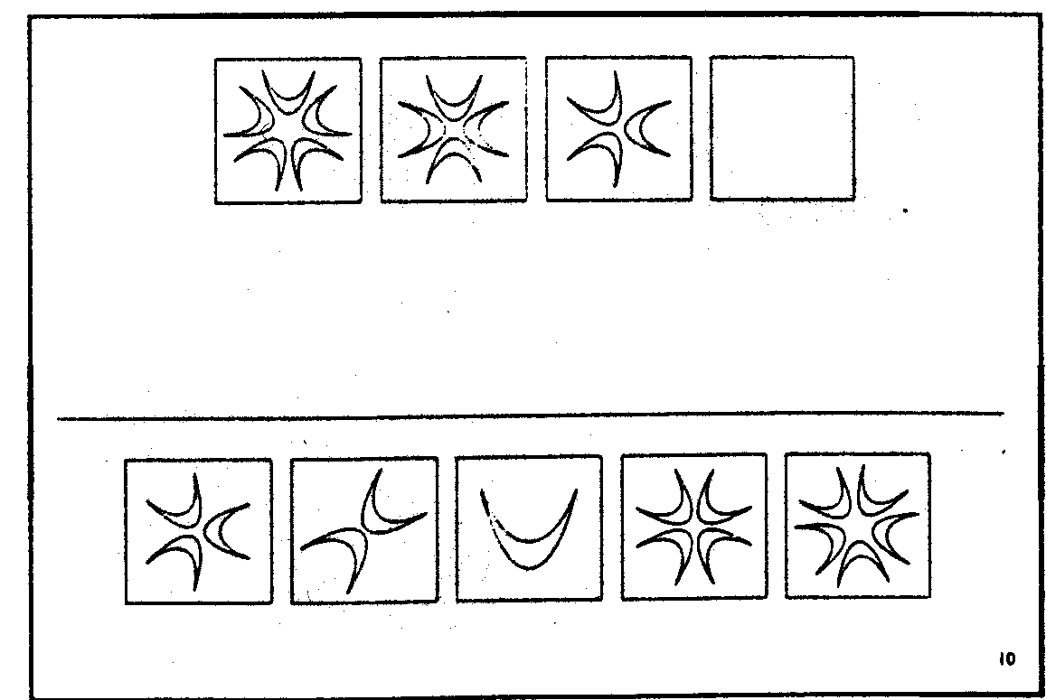
Sequential reasoning - geometric

Slide 12
Counter Cultural Intelligence Tests
1970s
Cultural/Regional Upper crust Savvy Test
Black Intelligence Test of Cultural Homogeneity
Adrien Dove
The Chitling Intelligence Test

Slide 13
The Chitling Intelligence Test
1) A “gas head” is a person who has a:
a. fast moving car
b. stable of “lace”
c. “process”
d. habit of stealing cars
e. long jail record for arson

Slide 14
The Chitling Intelligence Test
2) If a pimp is uptight with a woman who gets state aid, what does he mean when he talks about “mother’s day”?
a. second Sunday in May
b. third Sunday in June
c. first of every month
d. first and fifteenth of every month

Slide 15
The Chitling Intelligence Test
3) A “handkerchief head” is:
a. a cool cat
b. a porter
c. an Uncle Tom
d. a hoddi
e. a preacher

Slide 16
The Chitling Intelligence Test
4) If a man is called a “blood” then he is a:
a. fighter
b. Mexican-American
c. Negro
d. hungry hemophile
e. red man, or Indian

Slide 17
The Chitling Intelligence Test
5) Cheap chitlings will taste rubbery unless they are cooked long enough. How soon can you quit cooking them to eat and enjoy them?
a. forty-five minutes
b. one hour
c. two hours
d. twenty-four hours
e. one week (on a low flame)

Slide 18
Tests of Creativity
Measures Divergent Thinking
(intelligence tests measure Convergent thinking)

Slide 19
Creativity
“not the ability to solve problems, but the ability to discover the right problem that needs to be solved = problem finding”
“process involved in solving ill-defined problems”

Slide 20
Intelligence = creativity???
No relationship
Hi intelligence + low creativity = addicted to school, well liked by teachers
Hi creativity + low intelligence = less popular

Slide 21
Domains of Giftedness
General intellectual ability
Specific academic aptitude
Creative or productive thinking
Leadership ability
Visual and performing arts
Psychomotor ability

Slide 22
Torrance Test of Creative Thinking (TTCT)
1) Flexibility (number of different categories)
2) Fluency (examples within a category)
3) Originality
4) Elaboration

Slide 23
Example 1
What is a brick?
Versus
How could you use a brick?

Slide 24
Example 2
If a boy goes to the store and buys 30 cents worth of candy and he gives the store keeper one dollar how much change will he get?
Versus..
How many different ways can you think of to get the answer “4”?

Slide 25
Example 3
Find the absurdity in the picture.
Versus..
How could you make this toy better?

Slide 26
Example 4
Glove is to hand as shoe is to_______?
Versus..
Write all the meanings you can think of for the word “bolt”.

Slide 27
Divergent Production Test (Guilford)
Here is a simple, familiar form: a circle. How many pictures of real objects can you make using a circle, in a one minute period?

Slide 28
2. Many words begin with an L and end with an N. List as many words as possible in a one minute period, that have the form L___N (they can have any number of letters between the L and the N).

Slide 29
3. Suppose that people reached their final height at the age of 2, and so normal adult height was less than a meter. In a one minute period, list as many consequences as possible that would result from this change.

Slide 30
Here is a list of names. They can be classified in many ways. For example, one classification would be in terms of the number of syllables. Classify them in as many ways as possible in a one minute period.
Beth Harold Gail John Lucy Sally

Slide 31
Here are four shapes. Combine them to make each of the following objects: a face, a lamp, a piece of playground equipment, a tree. Each shape may be used once, many times, or not at all in forming each object, and it may be expanded or shrunk to any size.

Slide 32
Other non traditional intelligence assessment examples.

Slide 33
Knowledge acquisition
Two ill-dressed people, one a haggard woman of middle years and the other a young man, sat around the fire where the common meal was almost ready. The mother, Tanith, peered at her son through the oam of the bubbling stew. It had been a long time since his last ceilidh, and Tobar had changed greatly. Where once he had seemed all legs and clumsy joints, he now was well formed and in control of his supple, young body. As they ate, Tobar told of his past year, recreating for Tanith how he had wandered long and far in his quest to gain the skills he would need to be permitted to rejoin the tribe. Then, all too soon, their brief ceilidh ended, tobar walked over to touch his mother’s arm and quickly left.

Slide 34
Testing Using Novel Problems
Calm Storm

Slide 35
Testing Using Novel Problems
The Weather
she’s

Slide 36
Testing Using Novel Problems
ST THE ORY

Slide 37
Miller Analogy Test (MAT)
Developed 1914 by WS Miller
Computerized 2007
120 questions in 60 minutes
May be used to replace GRE score

Slide 38
What is an analogy:
An analogy is a way of showing that two
situations share a relational structure by
identifying a sameness in the relationship
despite surface differences.

Slide 39
Traditional Analogies
Einstein is to Relativity as
Darwin is to:
Gravity/Planetary orbits/Evolution/Magnetism

Slide 40
Novel Analogies
Toasters write cookbooks
Spatula is to Utensil
as toaster is to:
writer/appliance/bread/book

Slide 41
Novel Analogies
Villains are lovable
Hero is to admiration
as villain is to:
contempt/affection/cruel/kind

Slide 42
Remote Associates Test (RAT)
Mednick and Mednick
1967
Creativity = “ability to see relationships between ideas that are remote from each other”

Slide 43
Remote Associates
Rough Resistance Beer
Charming Student Valiant
Foot Catcher Hot
Hearted Feet Bitter
Dark Shot Sun
Canadian Golf Sandwich
Tug Gravy Show
Attorney Self Spending
Magic Pitch Power

