Slide 1
Projective Personality Tests
Ambiguous stimuli
Subject’s response (themes)
Interpretation of response
reveal unconscious or hidden thoughts
can’t fake good/bad
scoring templates
- interpretation still an art

Slide 2
Types of projective tests
Completion (sentences or stories)
Associations (to words or pictures)
Construction (to stimuli)
Arrangement (of stimuli - e.g. pictures)
Expression (drawing or play)

Slide 3
Completion
Sentence completion
My best characteristic is……
My greatest fear is………
I only wish my mother had…….
Story completion

Slide 4
Associations
Free association
Word association
Ambiguous stimuli

Slide 5
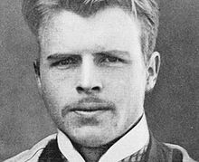
Rorschach Inkblot Test
Herman Rorschach(1921)

Slide 6
10 bilaterally symmetrical images
(5 black/white, 2 gray/red, 3 multi)
predetermined sequence
repeat sequence up to 3 times
Exner’s scoring system

Slide 7
Examples of Rorschach Inkblots

Slide 8
Scoring the Rorschach
Major Criteria
Location (where on the inkblot?)
Determinant (what feature is used?)
form, movement, color, texture
Content (what was the percept?)
human, human detail, explosion, X-ray
Popular versus Original

Slide 9
Construction (adult)
Of stories - tests for adults
Thematic Apperception Test (TAT)
Murray - 1943
ages 14 - 40
30 pictures - 1 blank
shown in two sessions of 10 pictures
pictures used varies

Slide 10
TAT story elements:
Event shown in the picture
What has led up to it
What the characters in the picture are feeling and thinking
Outcome of the event

Slide 11
TAT examples

Slide 12
Construction (children)
Of stories
The Blacky Pictures (1946)
Gerald Blum
5 to adult
psychoanalytic
12 pictures (cartoons of animals)
makes up story
also answers 6-7 questions about each

Slide 13
Construction
Of stories - tests for children
Children’s Apperception Test (CAT)
Leopold Bellak (1950)
ages 3 to 10
CAT-A = animals in human context
CAT-H = uses human figures
CAT-S = animal figures in family situations
10 jigsaw like pictures - can manipulate them

Slide 14
Construction
Of stories - multicultural
Tell-Me-A-Story (TEMAS) (1988/1993)
Costanintino, Malgady & Rogler
ages 5 -18
23 pictures – 11 sex-specific (x2)
Hispanic and African-American or White in Urban settings

Slide 15
Expression
Symbolic play

Slide 16
Drawings - link
Draw a Person (Florence Goodenough - 1926)
-- children 3-17
-- difficulties with social adjustment
I would like you to draw a picture of a person
Now - a person of the opposite sex
Tell a story about the person

Slide 17
House-Tree-Person - link
John Buck (1948)
Anyone over age 3
May be on 1 or 3 sheets of paper
House = child’s feelings to family
Tree = feelings of strength or weakness
Person = child’s self-concept

Slide 18
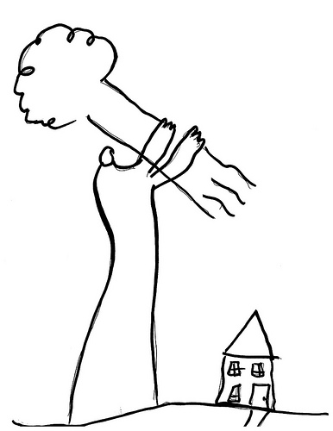
House-Tree-Person

Slide 19
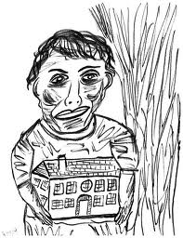
House-Tree-Person

Slide 20
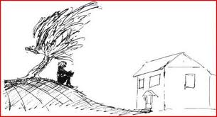
House-Tree-Person

Slide 21
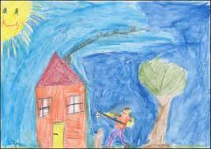
House-Tree-Person

Slide 22
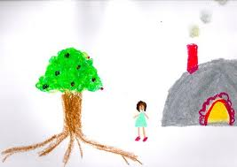
House-Tree-Person

Slide 23
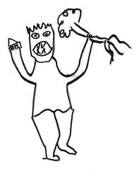
House-Tree-Person

Slide 24
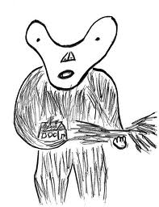
House-Tree-Person

