Slide 1
Scales of Measurement
Nominal
classification
labels
mutually exclusive
exhaustive
different in kind, not degree

Slide 2
Scales of Measurement
Ordinal
rank ordering
numbers reflect “greater than”
only intraindividual hierarchies
NOT interindividual comparisons

Slide 3
Scales of Measurement
Interval
equal units on scale
scale is arbitrary
no 0 point
meaningful differences between scores

Slide 4
Scales of Measurement
Ratio
true 0 can be determined

Slide 5
Contributions of each scale
Nominal
creates the group
Ordinal
creates rank (place) in group
Interval
relative place in group
Ratio
comparative relationship

Slide 6
Project question #2
2. Which scale is used for your measure?
Is it appropriate? – why or why not?
Are there alternate scales that could be used to represent the data from your scale? If so how?

Slide 7
Graphing data
X Axis
horizontal
abscissa
independent variable

Slide 8
Y Axis
vertical
ordinate
dependent variable

Slide 9
Types of Graphs
Bar graph
qualitative or quantitative data
nominal or ordinal scales
categories on x axis, frequencies on y
discrete variables
not continuous
not joined

Slide 10
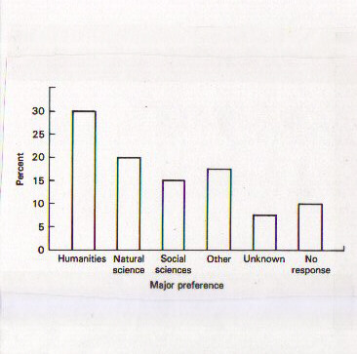
Bar Graph

Slide 11
Types of Graphs
Histogram
quantitative data
continuous (interval or ratio) scales

Slide 12
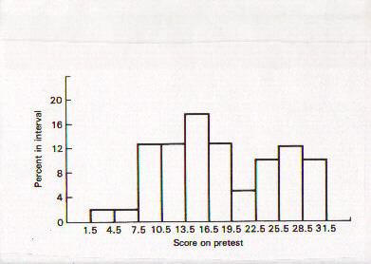
Histogram

Slide 13
Types of Graphs
Frequency polygon
quantitative data
continuous scales
based on histogram data
use midpoint of range for interval
lines joined

Slide 14
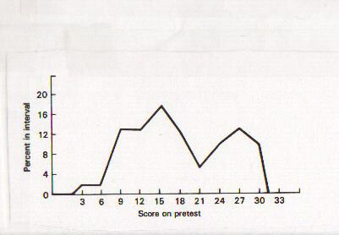
Frequency Polygon

Slide 16
Project question #3
3. What sort of graph(s) would you use to display the data from your measure?
Why would you use that one?

Slide 17
Interpreting Scores

Slide 18
Measures of Central Tendency
Mean
Median
Mode

Slide 19
Measures of Variability
Range
Standard Deviation

Slide 20
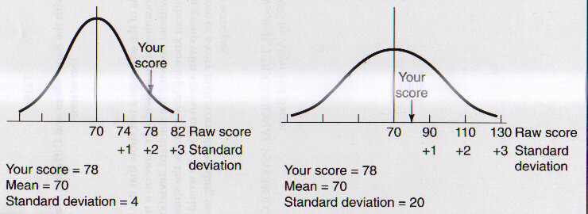
Effect of standard deviation

Slide 21
Assumptions of Normal Distribution (Gaussian)
The underlying variable is continuous
The range of values is unbounded
The distribution is symmetrical
The distribution is unimodal
May be defined entirely by the mean and standard deviation

Slide 22
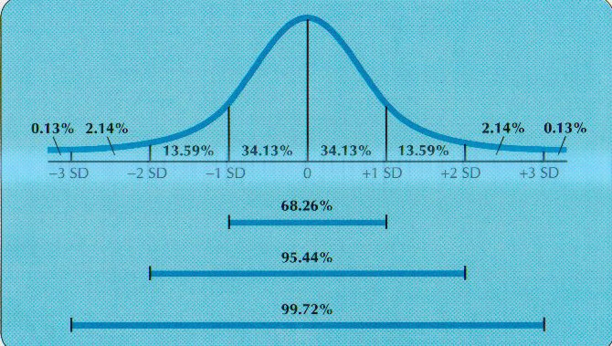
Normal Distribution

Slide 23
Terms of distributions
Kurtosis
Modal
Skewedness

Slide 24
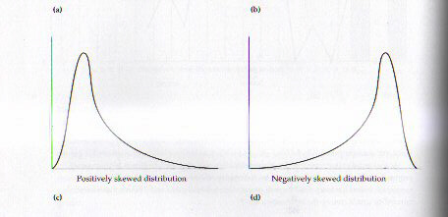
Skewed distributions

Slide 25
Linear transformations
Expresses raw score in different units
takes into account more information
allows comparisons between tests

Slide 26
Linear transformations
Standard Deviations + or - 1 to 3
z score 0 = mean, - 1 sd = -1 z, 1 sd = 1 z
T scores
removes negatives
removes fractions
0 z = 50 T

Slide 27
Example
T = (z x 10) + 50
If z = 1.3
T = (1.3 x 10) +50
= 63

Slide 28
Example
T = (z x 10) + 50
If z = -1.9
T = (-1.9 x 10) +50
= 31

Slide 29
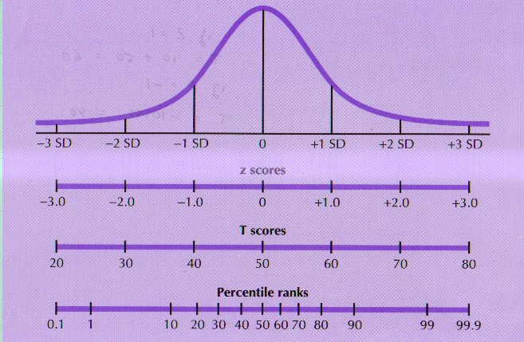
Linear Transformations

Slide 30
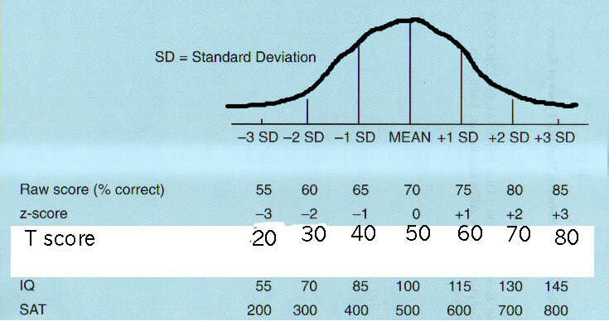
Examples of linear transformations

