Slide 1
Intelligence tests
Wechsler Tests
Info on David Wechsler

Slide 2
Wechsler Adult Intelligence Scale – WAIS
Original in 1939 – W-B I
WAIS-IV - 2008
Ages 16 through 90

Slide 3
Wechsler Intelligence Scale for Children WISC
Original in 1949
Ages 6 through 16
WISC-R in 1974
WISC-IV in 2003

Slide 4
Wechsler Preschool and Primary Scale of Intelligence WPPSI
Original in 1963
Ages 3 to 7 years
WPPSI-III in 2002

Slide 5
Common features of Wechsler tests
Full Scale IQ
2 major second level categories
12 – 15 subtests
Individually administered
50-70 minutes administration time
Normative data
Comprehensive manuals

Slide 6
Revisions:
More contemporary – words, pictures, terms
More culture free
Better norms
More theoretical base (CHC model)
Link to information on CHC model

Slide 7
Cattell-Horn-Carroll (CHC) model
General factor of intelligence (g)
Started with Gf-Gc theory (fluid/crystallized)
Specific abilities (number varies)

Slide 8
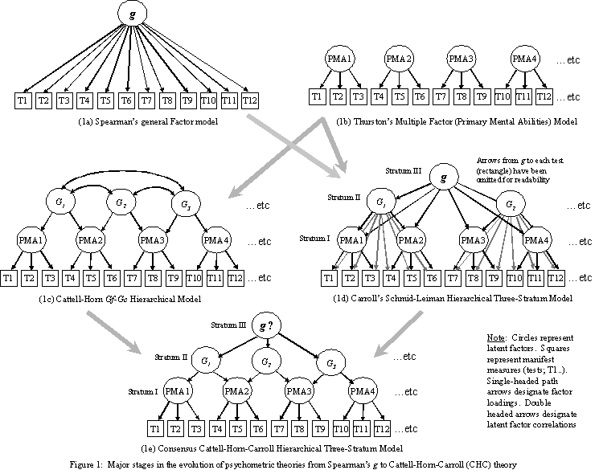
CHC model

Slide 9
Test scores
Full Scale IQ
Verbal Comprehension index
Perceptual Reasoning index
Working Memory index
Processing Speed index

Slide 10
Sub-tests
Picture completion
Information
Coding
Similarities
Picture arrangement
Arithmetic
Block design
Vocabulary
Object assembly
Comprehension
Symbol search
Digit span
Mazes

Slide 11
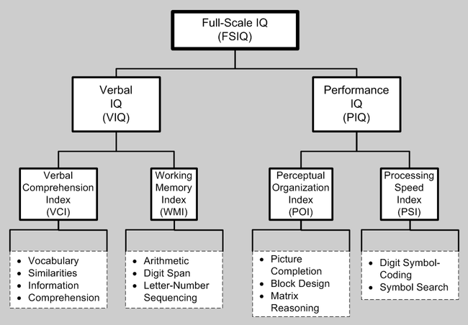
WAIS - IV

Slide 12
Psychometrics
Reliability - Internal consistency
Verbal = .97
Performance = .93
Split half = .95
Validity – multi-trait
High correlation with Binet

Slide 13
Web info on WISC IV
Model of WISC IV
Psychometrics of WISC IV

