Slide 1
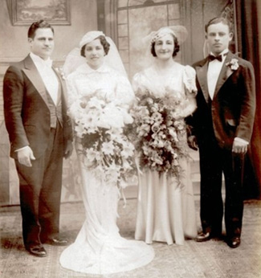
Family
Amy Sakellariou
American Sign Language I
Modern Language Department
SUNY Cortland

Slide 2
Table of Contents
Objectives
Parameters of a sign
Family signs
Handshape
Location
Palm Orientation
Location
Sign Names
Resources

Slide 3
Objectives
Students will be able to identify 5 parameters of a sign
Students will be able to demonstrate the signs for family members
Students will be able to understand what sign names are in Deaf culture

Slide 4

Five Parameters of a sign
Handshape
Location
Movement
Non Manual Markers
Palm Orientation
5 parameters of a Sign

Slide 5
Family Signs
Family
Mother
Father
Brother
Sister
Family Signs

Slide 6
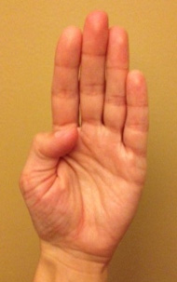
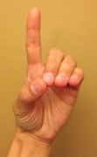
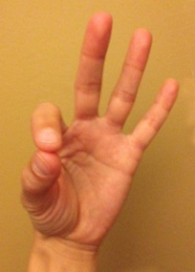
What is the handshape in ASL for the word family?

Slide 7
TRY AGAIN

Slide 8

GREAT JOB!

Slide 9
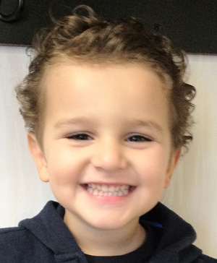
What is the location for the sign Father?
FOREHEAD
CHIN

Slide 10
What is the palm orientation for the sign brother?
Palm faces upward
Palm face downward
Palm faces left or right

Slide 11
What is location for the sign sister?
Chest
Chin
Forehead

Slide 12
Sign Names
Sign names in the very basic sense, are used in the Deaf culture to identify individuals.
A person’s sign name is the first letter of their name associated with a specific location and movement on the body or face.

Slide 13
Resources
Signing Naturally Levels I, II
  Cheri Smith, Ken Mikos, Ella Mae Lentz,
The Book of Name Signs, Naming in American Sign Language
  Samuel J. Supalla
American Sign Language Green Book
  Dennis Cokley, Charlotte Baker Shenk

