Slide 1

How to Write a Friendly Letter
What is a Friendly Letter?
Greeting
Heading
Body
Closing
Signature
Who Can We Write To?
Pen Pals
Practice
Bibliography
Main Page

Slide 2
What is a Friendly Letter?
A friendly letter (note) is written to share news about yourself and to ask/answer questions to get to know someone better
There are five different parts to a friendly letter. Click the links below to navigate and learn. Go back to the home page after reviewing, or continue pressing the right arrow.
Heading
Greeting
Body
Closing
Signature

Slide 3
Heading
The heading is where you write the address you are writing from and the date you are writing the letter.
Rachael Forester
36 Graham Ave
Cortland, NY 13045
November 1, 2012
The heading goes on the top right corner of your letter.
Click to see where the heading belongs

Slide 4
Greeting
The greeting is where you say hello to who you are writing to. Remember to always use a comma after the greeting.
Hello Amy,
Dear Todd,
Greetings Susie,
Click to see where the greeting belongs

Slide 5
Body
This is the main part of your letter. In the body, you tell why you are writing the letter, you ask questions, and answer them also.
I am writing this letter to see how your vacation was. What types of things did you do in California? How long were you there for? Did you drive or take an airplane? I’ve always wanted to go to a different state, so I can’t wait to hear all about it. Write back soon!
Click to see where the body belongs
The body comes after the greeting.

Slide 6

Closing
The closing is the part where you say goodbye to whoever you are writing to. You always need a comma after.
Goodbye,
Sincerely,
Until next time,
Hugs and kisses,
The closing goes after the body and is at the end of the letter.
Click to see where the closing belongs

Slide 7
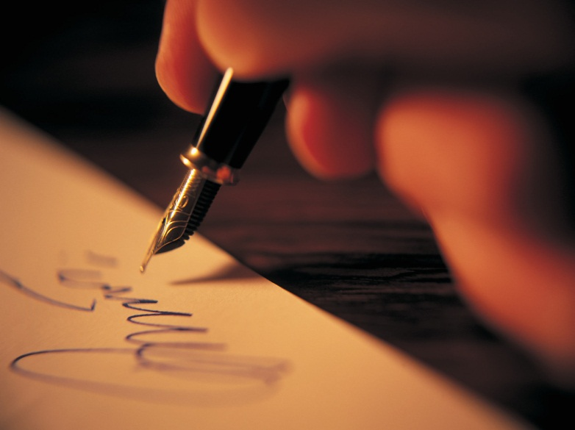
Signature
The signature is where you sign your name. It goes on the line below your closing.
This is the last part of your friendly letter!
Click to see where the closing belongs

Slide 8
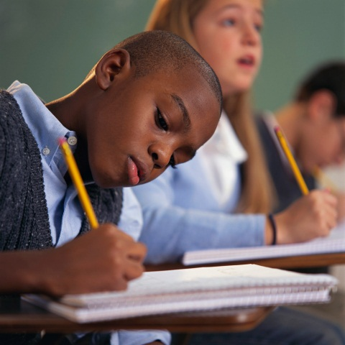
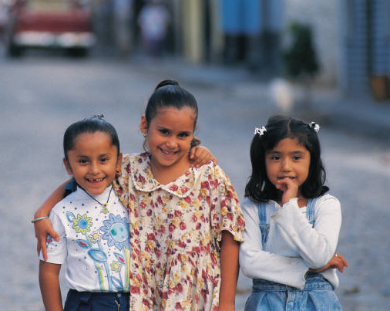
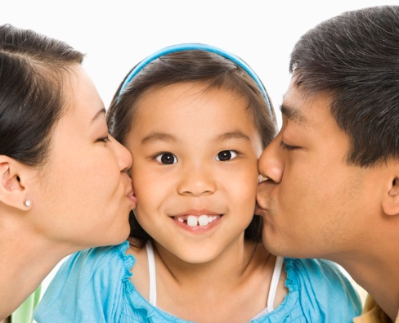
Who Can We Write To?
We can write a friendly letter to anyone that we want to learn more about. Click on the pictures below to see some examples.
Friends
Family
Pen Pal
Author

Slide 9

Pen Pals
You will all be writing a friendly letter to a pen pal!
What is a pen pal?
A pen pal is a person that you write letters back and forth to. You will be writing to students in Ms. Smith’s ESL class.
First, you need to practice writing a friendly letter!

Slide 10
Practice
is the last part of the letter NO!
tells why you are writing YES!
tells us the date NO!
1. The body of the letter _________________________________________.
a. tells us the date
b. tells why you are writing
c. is the last part of the letter
tells us the date YES!
says hello NO!
Is where you sign your name NO!
2. The heading of the letter _________________________________________.
a. says hello
b. is where your sign your name
c. tells us the date

Slide 11
Practice
says hello NO!
is where you sign your name NO!
says goodbye YES!
3. The closing of the letter _________________________________________.
a. says goodbye
b. is where you sign your name
c. says hello
is where you sign your name YES!
is where you say hello NO!
tells us your address NO!
4. The signature of the letter _________________________________________.
a. tells us your address
b. is where you sign your name
c. is where you say hello

Slide 12
Practice
is where you write the date NO!
is where you say hello YES!
is where you say goodbye. NO!
5. The greeting of the letter _________________________________________.
a. is where you say goodbye
b. is where you write the date
c. is where you say hello
Once you get all of the questions correct (right), please take out your notebook and start writing a friendly letter to your pen pal. Your pen pal is written on the board.

Slide 13
Start Writing!
Bibliography

Slide 14
Bibliography
Friendly letter picture from Google Images and was resized in Photoshop.
Stick figure with the five part of a friendly letter is original clip art by Rachael Forester.
All other photos were from clipart through PowerPoint.
Friendly Letter Song is by Beth Pergola.
Pen Pal audio is an original edited clip by Rachael Forester.

Slide 15
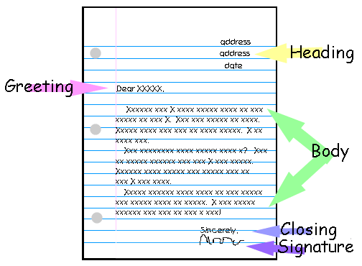
What Should it Look Like?

